Slide 1



Egyptian Premier League Analysis
Project Understanding
Gathering Data
Analyzing Data
Conclusions
By: Mahmoud Ahmed Shimy
Generating Questions
Cleaning Data

Slide 2
Table of content
Project Understanding
Gathering Data
Analyzing Data
Conclusions
Egytian premier league
Generating Questions
Cleaning Data
Analysing teams performance over seasons

Slide 3
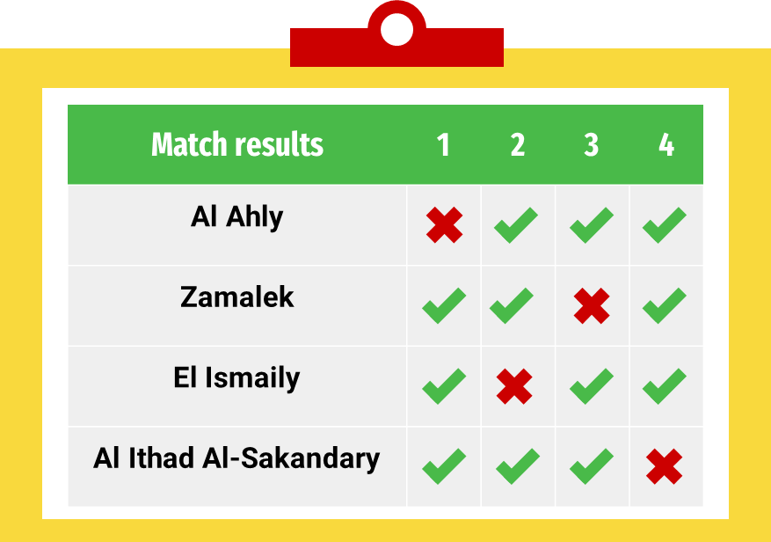
Goal
Project Understanding
Gathering Data
Analyzing Data
Conclusions
Generating Questions
Cleaning Data
Egytian premier league
Analysing teams performance over seasons

Slide 4
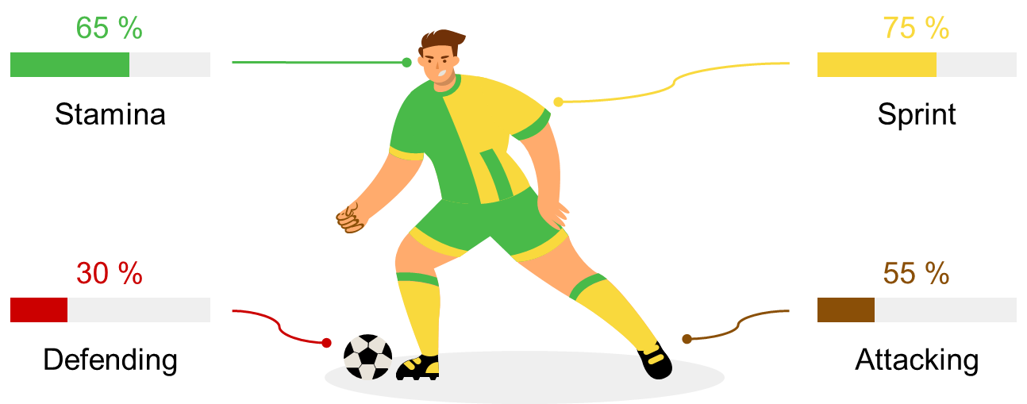
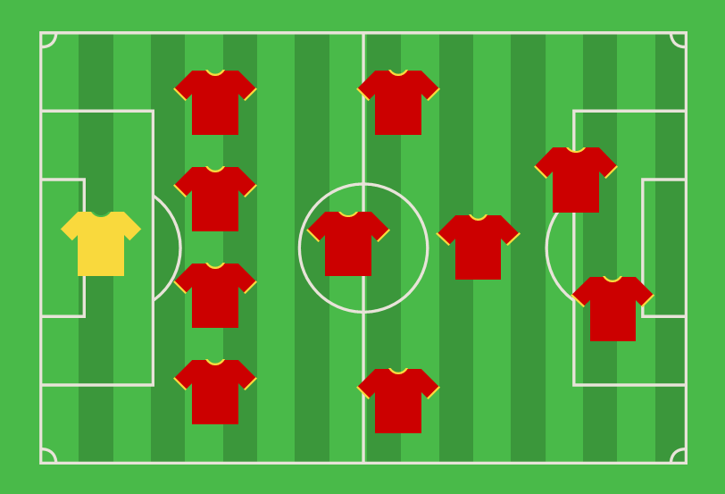
Project Understanding
Goal

Slide 5



Project Understanding
Goal

Slide 6

Project Understanding
Generating Questions
target audience
Goal
Season
Teams
For each season what is the different factors
For each team what is its performance over seasons
1
Qualification/ Relegation
Win/Lose
What is the trends on winning and losing in the league
Qualification and Relegation trends in the league

Slide 7


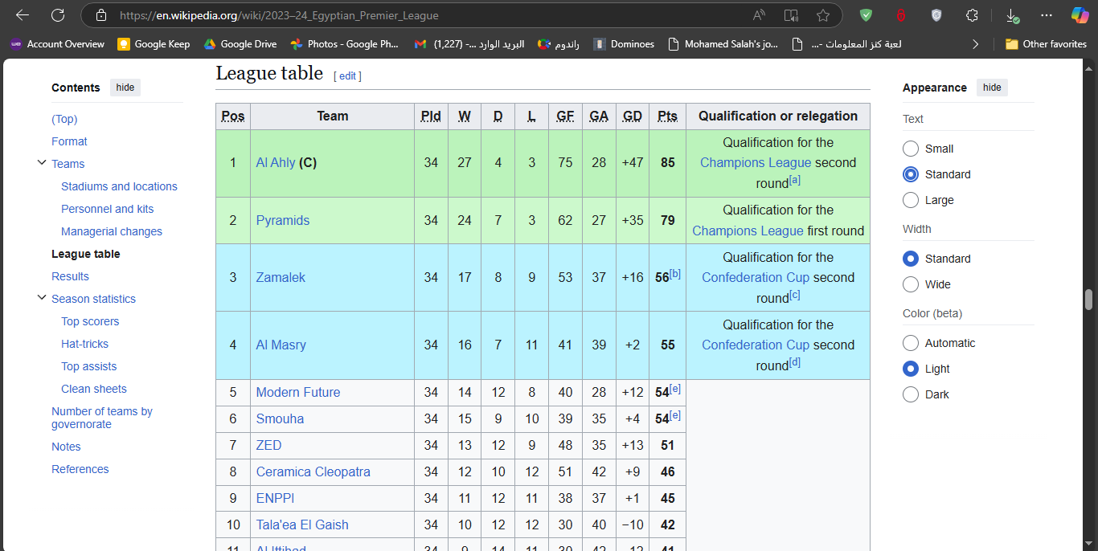


Project Understanding
Generating Questions
Gathering Data
target audience
Goal
Season
Teams
For each season what is the different factors
For each team what is its performance over seasons
1
0
Win/Lose
Qualification/ Relegation
What is the trends on winning and losing in the league
Qualification and Relegation trends in the league

Slide 8
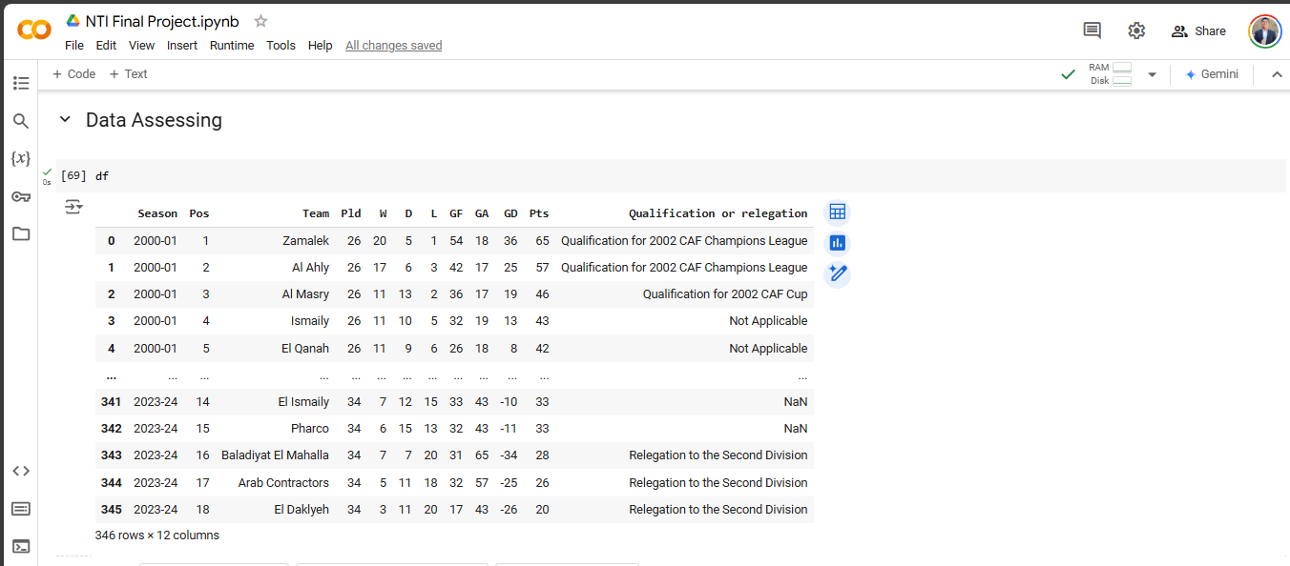
Generating Questions
Gathering Data
Season
Teams
For each season what is the different factors
For each team what is its performance over seasons
1
0
Win/Lose
What is the trends on winning and losing in the league
Qualification/ Relegation
Qualification and Relegation trends in the league

Slide 9
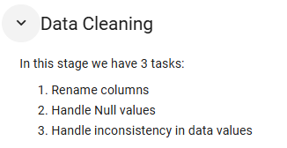
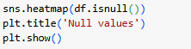
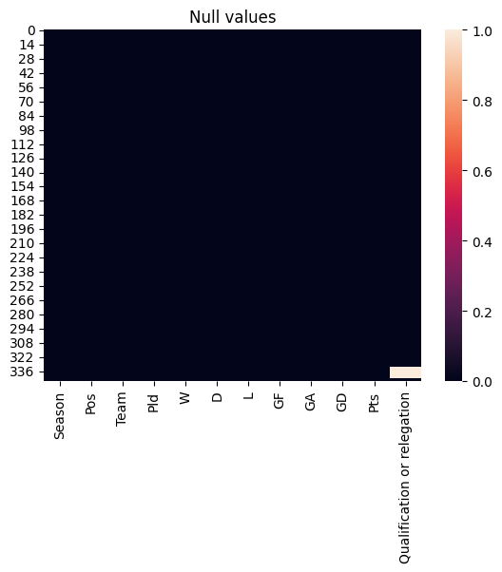
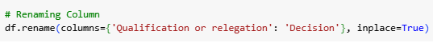
Gathering Data

Slide 10
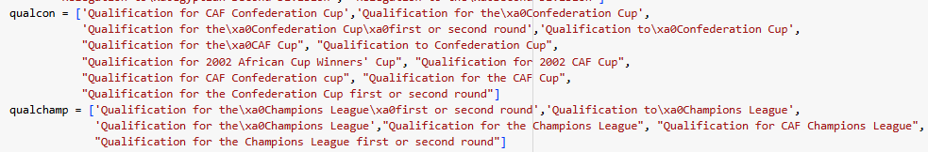
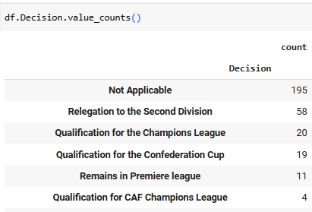
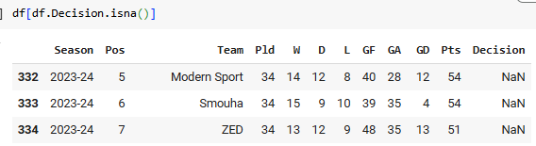
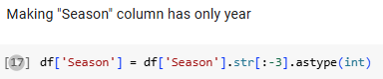
Gathering Data
Cleaning Data

Slide 11
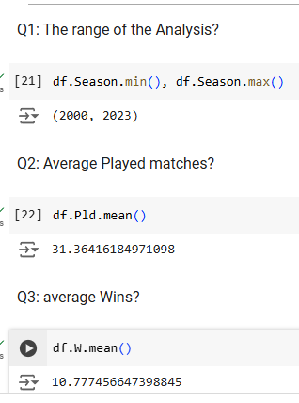
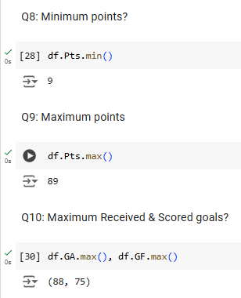
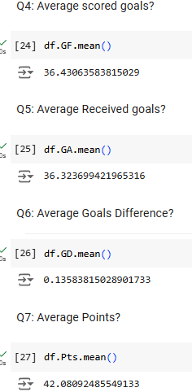
Cleaning Data

Slide 12
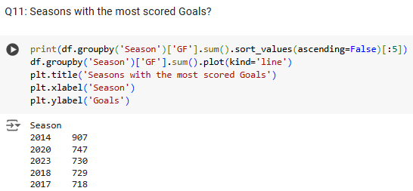
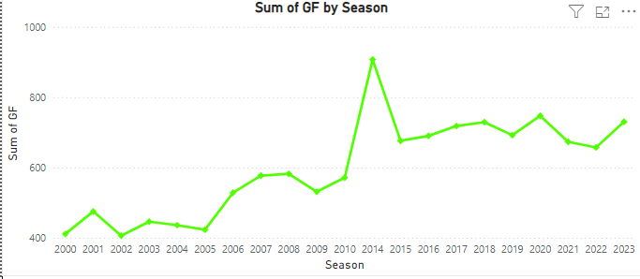
Cleaning Data
Analyzing Data

Slide 13
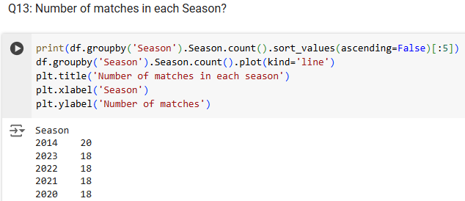
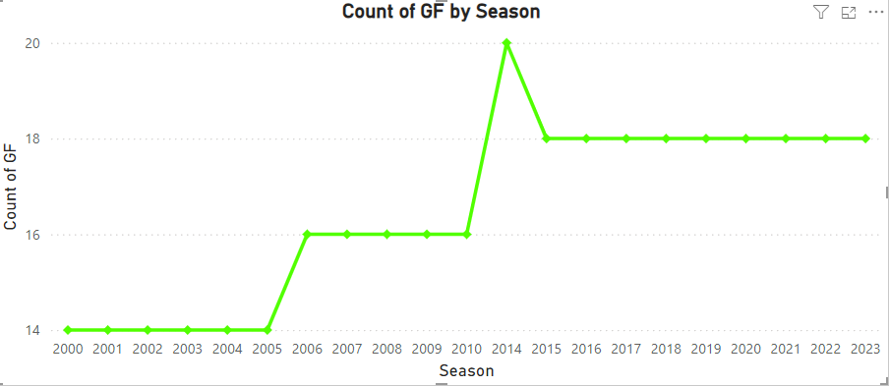
Analyzing Data

Slide 14
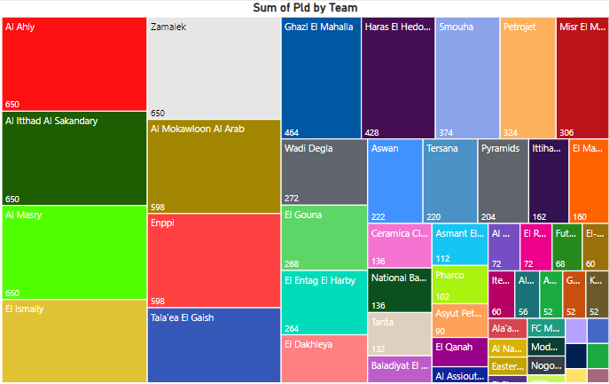
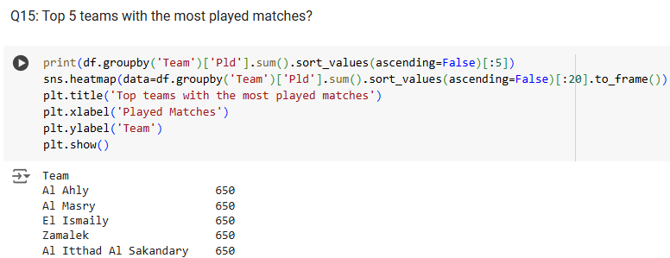
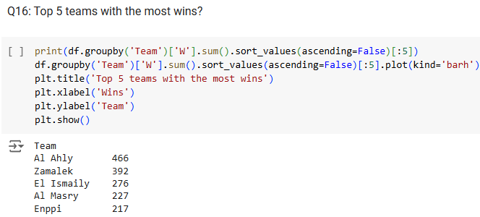
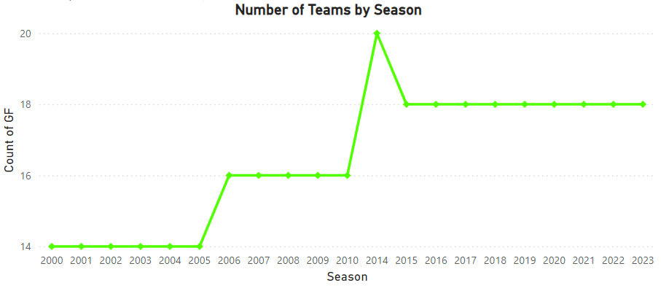
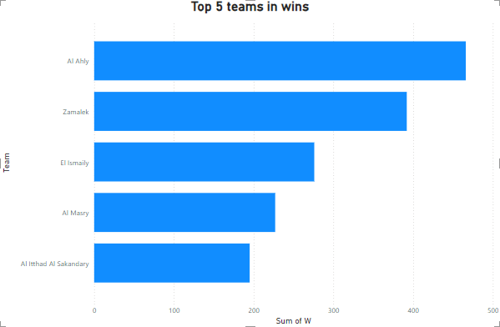
Analyzing Data

Slide 15
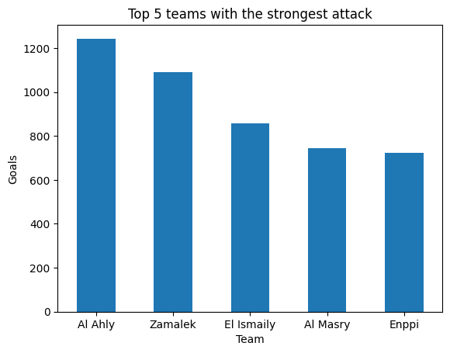
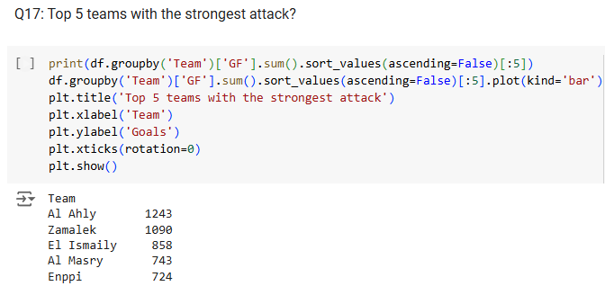
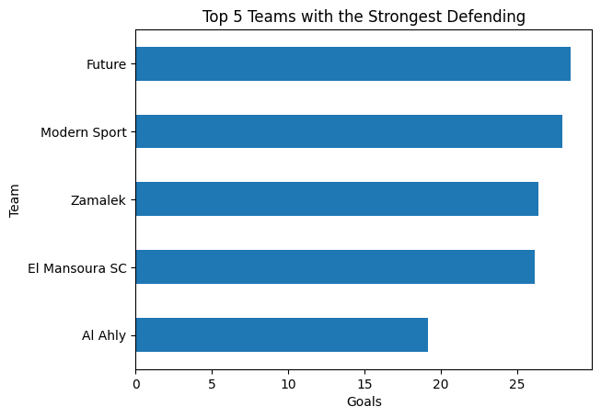
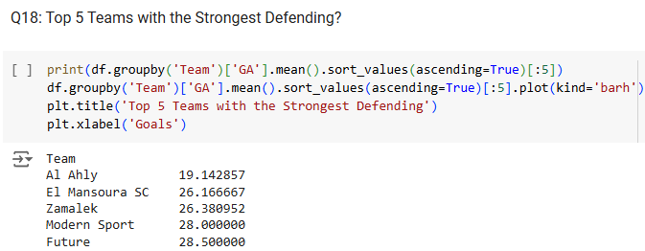
Analyzing Data

Slide 16
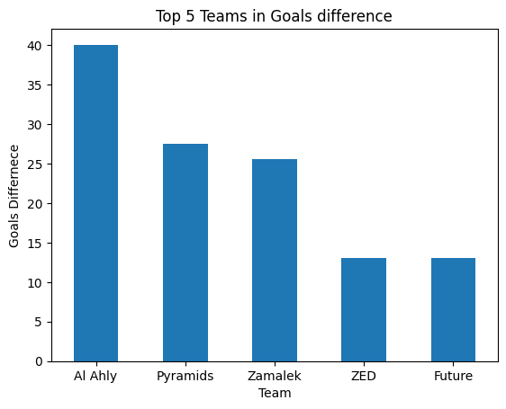
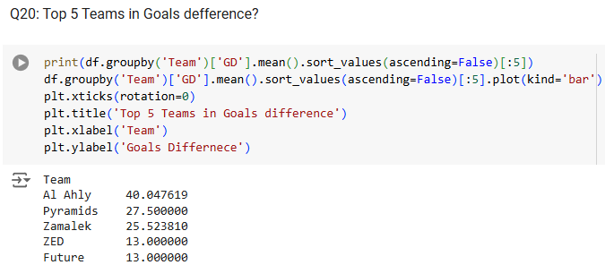
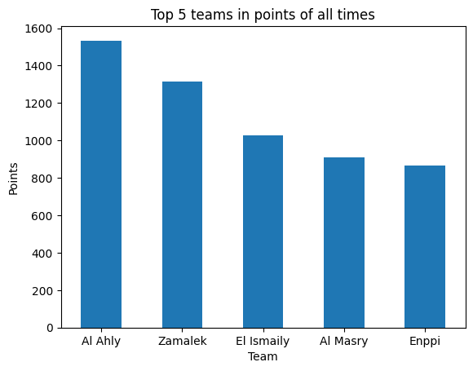
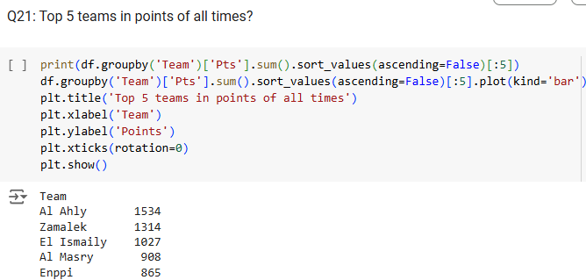
Analyzing Data

Slide 17
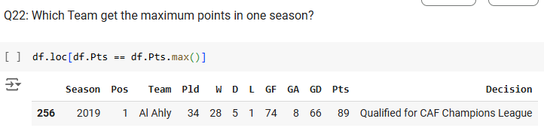
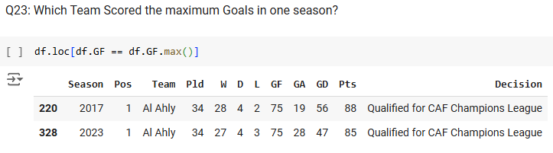
Analyzing Data

Slide 18
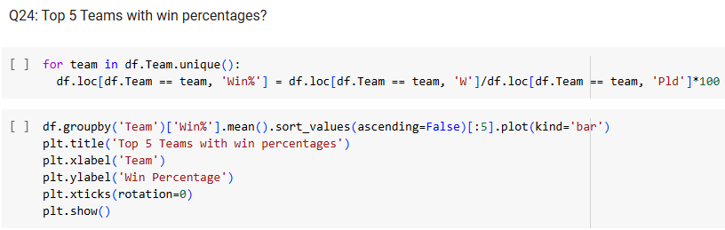
Analyzing Data
Future
46%
El Esmaily
Al Ahly
Zamalek
43%
72%
61%
Pyramids
58%

Slide 19
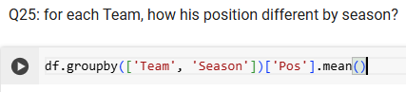
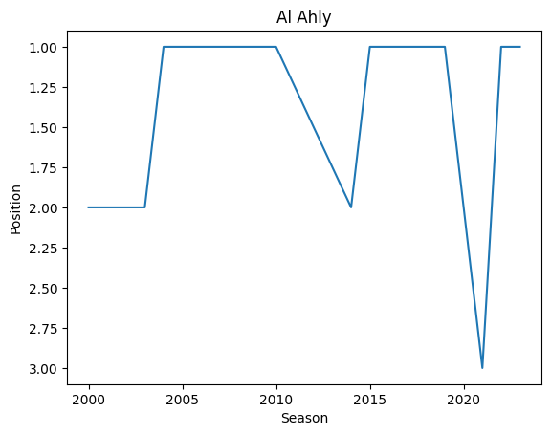
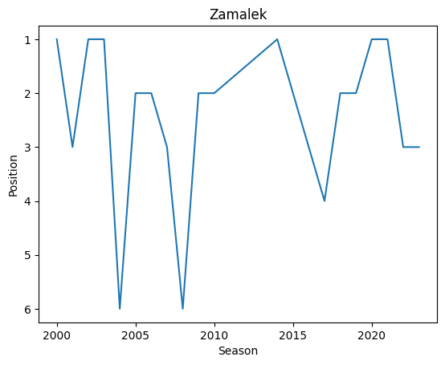
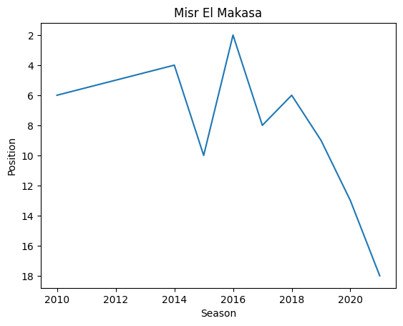
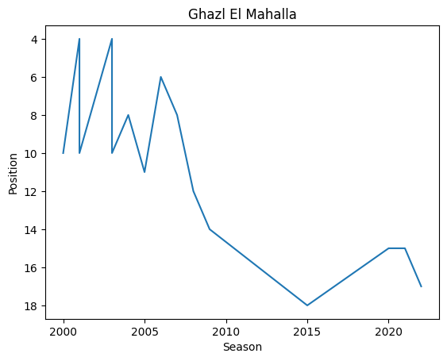
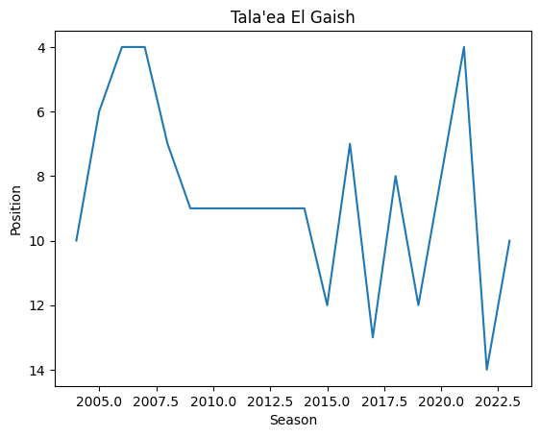
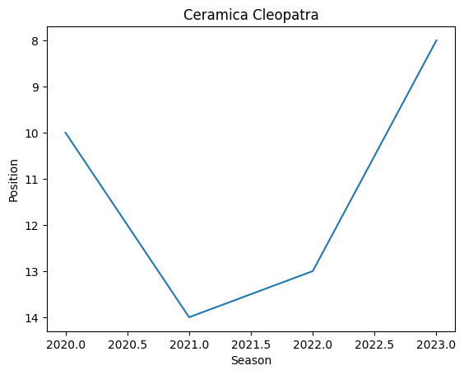
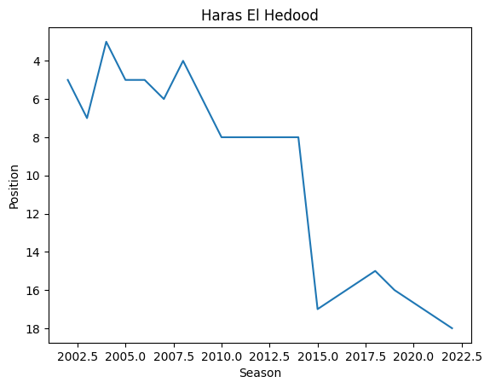
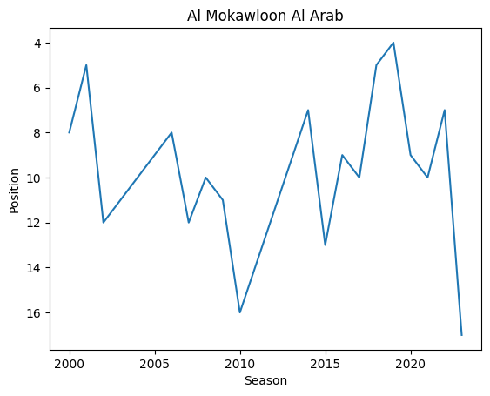
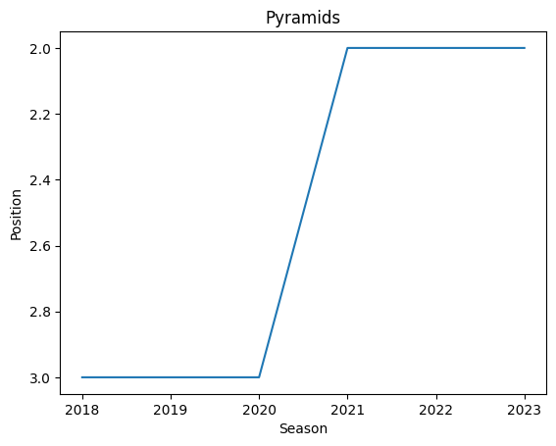
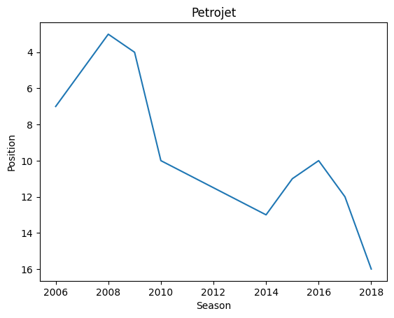
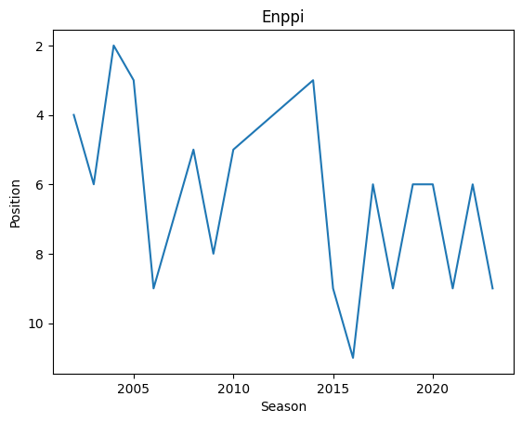
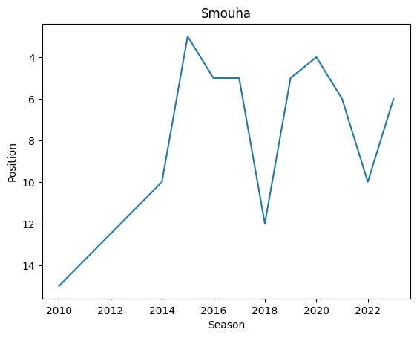
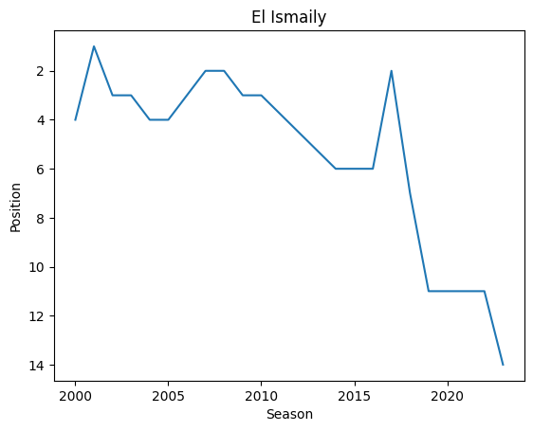



Analyzing Data
Future
46%
El Esmaily
Al Ahly
Zamalek
Pyramids
43%
72%
61%
58%

Slide 20






Analyzing Data
Future
46%
Pyramids
58%
El Esmaily
Al Ahly
Zamalek
43%
72%
61%

Slide 21






Analyzing Data

Slide 22
Conclusion
Analyzing Data
Ceramica Cleopatra
Al Ahly
Top Promising
Best Attack
Pyramids
Zamalek
Al Itthad Al Sakandary
Al Ahly
Top Safe
Best Defending
Tala'ea El Gaish
El Mansoura SC
Conclusions

Slide 23

Conclusion
Analyzing Data
THANKS!
By: Mahmoud Shimy
Ceramica Cleopatra
Al Ahly
Top Promising
Best Attack
Pyramids
Zamalek
Conclusions
Al Itthad Al Sakandary
Al Ahly
Top Safe
Best Defending
Tala'ea El Gaish
El Mansoura SC

Slide 24

Ceramica Cleopatra
Al Ahly
Top Promising
Best Attack
Pyramids
Zamalek
Al Itthad Al Sakandary
Al Ahly
Top Safe
Best Defending
Tala'ea El Gaish
El Mansoura SC
Conclusions

Slide 25


Slide 26

THANKS!
By: Mahmoud Shimy

Slide 27
THANKS!
By: Mahmoud Shimy

